Slide 1
Roles in programming project
Przemysław Kostyra
Jakub Rypina

Slide 2
Programming project
Project manager
Analyst
Designer
Programmer
Testing team
Maintainer

Slide 3
In a big programming projects for every stage there is one or more people responsible for it.
In small projects one person may be responsible for more than one stage of process
- analyst / designer and programmer
- analyst and designer / programmer

Slide 4
Structure of a team
There are two basic team structure:
net star

Slide 5
Users
They aren’t in the team but contacts with them are very important.
There are three types of users:
-operational users
-supervisory users
-executive users

Slide 6
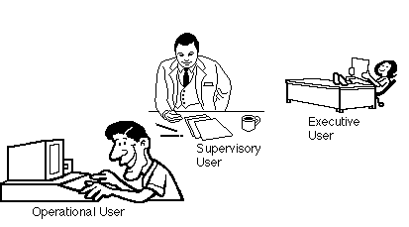

Slide 7
Characteristics of different users
Operational user | Supervisory user | Executive user
Usually has a local view | May or may not have local view | Has a global view
Carries out the function of the system | Generally familiar with operation | Provides initiative for the project
Has a physical view of the system | Driven by budget considerations | No direct operating experience
 | Often acts as a middleman between users and higher levels of management | Has strategic concerns

Slide 8
Auditors, quality assurance and standards bearers
Do we need auditors in our programming project?
What do usually do?

Slide 9
Problems that may occur
They start working at the very end.
Problems with notation.
Form is more important than substance.

Slide 10
Systems Analyst
Archaeologist and scribe
Innovator
Mediator
Project leader

Slide 11
SYSTEMS DESIGNERS
transform a technology-free statement of user requirements into a high-level architectural design
the systems designers are likely to be a “buffer” between the systems analysts and the programmers

Slide 12
PROGRAMMERS
Their mainly task is to implement system modules
Combined roles

Slide 13
Sumary
People have different personalities, which all influence their performace and their preferable role in the team

